Slide 1
www.sustain.dtu.dk
Registration deadline 7th November 2015
NB: Be quick - last year all seats were booked before deadline

Slide 2
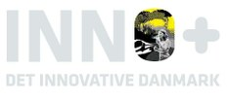
Background: The quest for a sustainable society
-and so the funding agencies call for…
Societal challenges of horizon2020
→ Health, demographic change and wellbeing;
→ Food security, sustainable agriculture, marine and maritime research and the bio-economy
→ Secure, clean and efficient energy;
→ Smart, green and integrated transport;
→ Climate action, resource efficiency and raw materials;
→ Inclusive, innovative and secure societies
Inno+:
Water, Resources, Green solutions, Climate, Sustainability…
Point 1 of 5: A society with a green economy
→ Future energy → From knowledge about water, environment and ressources to competitive technologies and solutions
→ The future climate and climate technologies
→ Bioresources, foodstuff and other bio products
The other 4 points: Health & Quality of life, Innovation, competitiveness, competence building.
Sustainability is the overarching goal of Horizon2020
- and essential in Forsk2020 & Inno+
It will be guiding research funding for years to come.

Slide 3
Background: Where are our new DTU engineers heading?
The large Danish export companies have a strong focus on green innovation and development.
They account for
of the total turnover within research and development,
Of the total green R&D expenses of the Danish companies.
… with the concept that “green transition” is about reducing the consumption of resources to get the world move towards an ideal situation with high growth without an environmental impact.
2
Ask yourself:
Will I be using more ‘green’ technology in the future?
How can we best prepare DTU engineers for this?
3
½
http://www.niras.dk/~/media/Files/NIRAS-DK/Aktuelt/Nyheder/pdf/Groen-omstilling.ashx

Slide 4
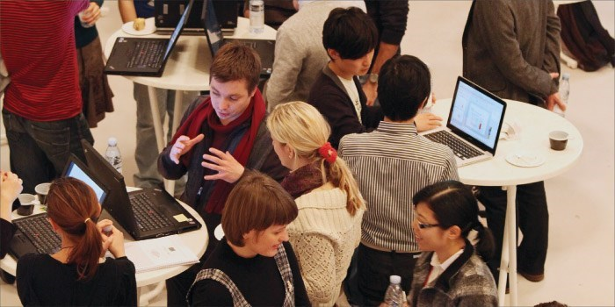
Vision for Sustain DTU
Claiming something is green is easy, but being able to document the expected impact is becoming increasingly important.
Knowledge Guides and information on assessing sustainable technologies
Funding An update on funding possibilities and provide information and help to create new research projects and apply for funding.
New teaching Find inspiration to create the new research and educational initiatives, as well as student projects testing out the ideas for the future research.
The aim of the conference is to give you
Presentations A forum to present your on-going research activities and ideas supporting the development of a sustainable society.
Connections The meeting place where you will get an overview of all the activities at DTU and likely find new collaborators and get new ideas.
Laptop presentations

Slide 5
Program for Sustain DTU
Time | Activity | Location
8 - 9 | Registration, Coffee and poster setup | Oticon; Posters will be in meeting centre and glassalen
9 - 10 | Welcome & morning plenum talks:Rector Anders Overgaard Bjarklev, DTU Welcome Katherine Richardson, KU Sustainability and the planetary boundaries to human activities Jock Martin, EEA The future of sustainability in a European perspective and the engineering challenges | Oticon
10 - 12 | Morning Sessions | Meeting centre
12 - 12.30 | Lunch | Meeting centre,Glassalen, Oticon
12.30 - 13.30 | Lunch Plenum talksClaus Stig Pedersen, Novozymes Sustainability as a business model Dieter Wegener, Siemens Sustainability and innovation management | Oticon
13.30 - 15.30 | Afternoon Sessions | Meeting centre
15.30-16 | Social Event, Poster Prize Ceremony | Glassalen
Venue:
Library/Oticon & meeting center

Slide 6
Sessions
10-12: Morning Sessions and Workshops:
A: Assessing Sustainability of Technologies
B: Bioprocess & Cell Factory Engineering
C: Competence Development in Sustainability
E: Sustainable Energy
F: Food Resources
I: Bio-inspired Functional Surfaces
J: Joint University Sustainability Initiatives
L: Smart Liveable Cities
M: Sustainable Materials
Z: Fundraisers lounge (drop-in workshop - continues at lunch time)
13.30 - 15:30 Afternoon Sessions and Workshops
G: Green Innovation and Entrepreneurship
P: Production – Focus on 3D printing
Q: Quality of Life
R: Biorefining
S: State of the Earth
T: Sustainability in a Chemical World
W: Water & Sustainability
X: Is your technology really sustainable? (Workshop)
Y: Kick-start Your Next Funding Application (Workshop)
Z: Fundraisers lounge (Drop-in Workshop)

